Slide 1
Serverless Computing
Lecturer: Ngo Huy Bien
Software Engineering Department
Faculty of Information Technology
University of Science
Ho Chi Minh City, Vietnam
nhbien@fit.hcmus.edu.vn

Slide 2

Objectives

Slide 3

Contents

Slide 4

References
Scott Hendrickson et al. (2016). Serverless Computation with OpenLambda.
Scott Hendrickson et al. (2016). Serverless Computation with OpenLambda. HotCloud.
Garrett McGrath and Paul R. Brenner (2017). Serverless Computing: Design, Implementation, and Performance.
Alexandru Agache et al. (2020). Firecracker - Lightweight Virtualization for Serverless Applications.

Slide 5
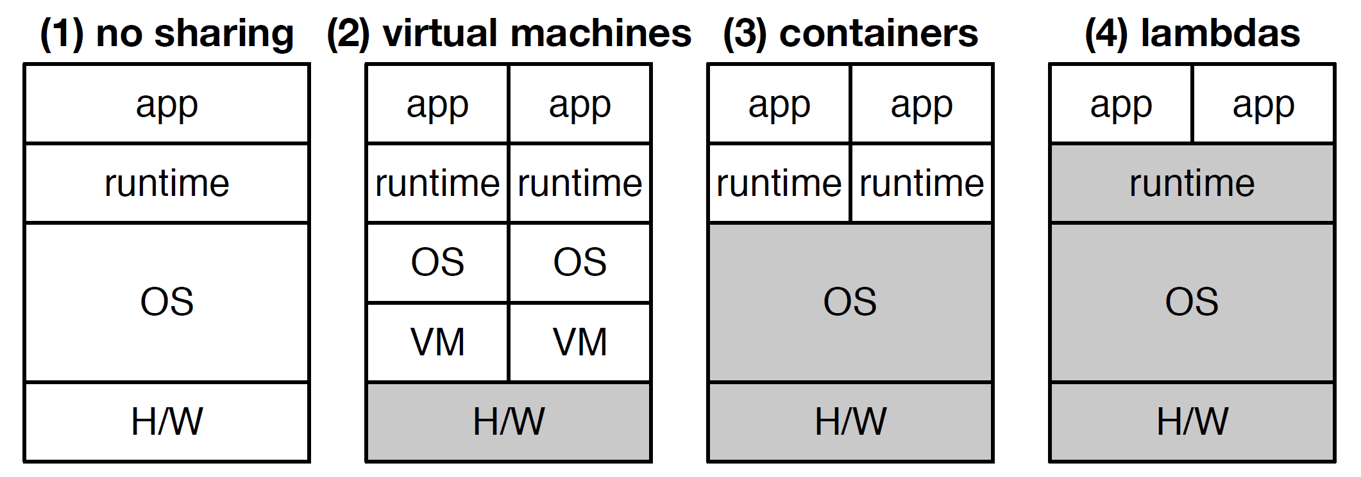
Evolution of Sharing [1]
Gray layers are shared.

Slide 6
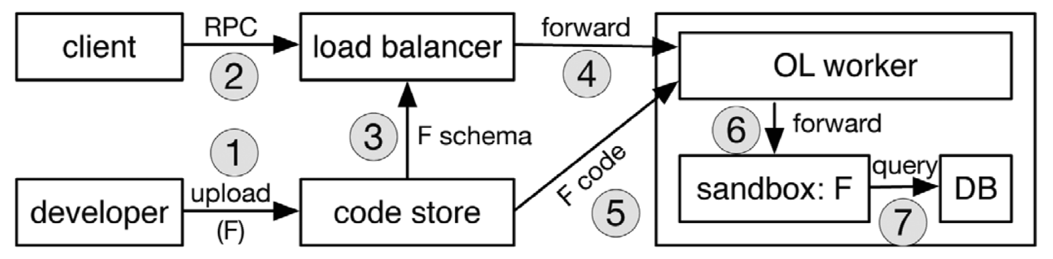
OpenLambda Architecture (I)
A new Lambda handler is uploaded, then called.

Slide 7
OpenLambda Architecture (II)
First, a developer uploads the Lambda code to the Lambda service, which stores it in a code store.
Second, a client may issue an RPC to the service, via AJAX, gRPC, or some other protocol.
A load balancer must decide which worker machine should service the request.
In order to implement certain locality heuristics, the balancer may need to request the RPC schema from the code store in order to perform deep inspection on the RPC fields.

Slide 8
OpenLambda Architecture (III)
The OpenLambda worker that receives the request will then fetch the RPC handling code from the code store if it is not already cached locally.
The worker will initialize a sandbox in which to run the handler.
The handler may issue queries to a distributed database; if the balancer and database are integrated, this will hopefully involve I/O to a local shard.

Slide 9
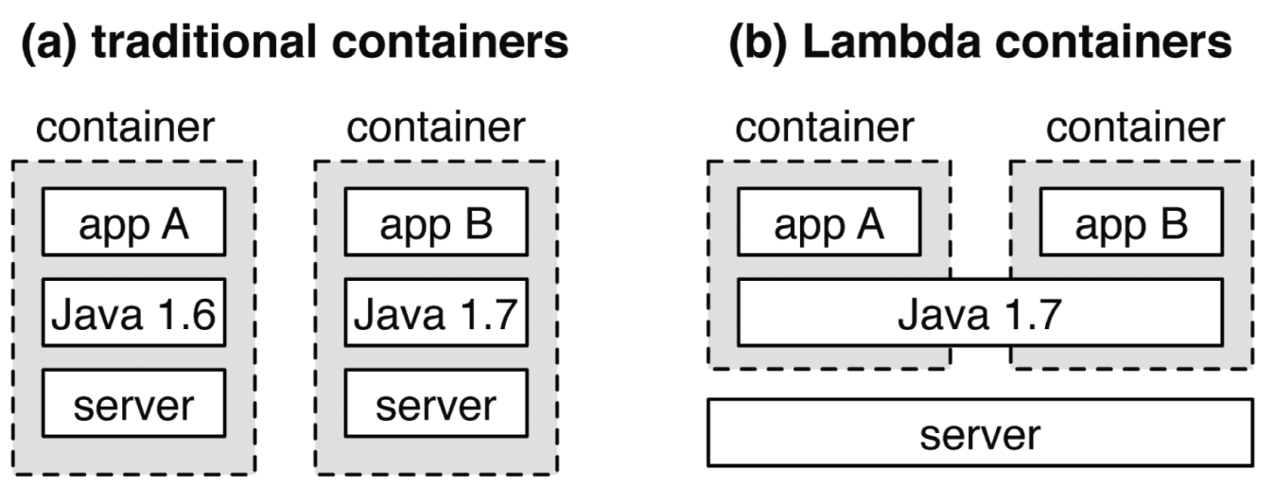
Container Usage
Servers run outside the containers with the Lambda model, so there is no server spinup overhead.
Many applications will share a small number of standard runtime engines.
Although multiple instances of those runtime engines will run in each sandbox, the runtime engine code will already be on every worker, typically in memory.

Slide 10


Slide 11
Programming Model [2]
A developer selects a runtime environment (e.g., Python27), uploads the relevant code, and specifies the name of the function that should handle events.
The developer can then associate the Lambda with a URL using the separate AWS gateway service.
Client-side code can then issue RPC calls by issuing requests to the URL (e.g., JavaScript may POST to the URL via AJAX).

Slide 12
Lambda Handlers
Lambda handlers from different customers share common pools of servers managed by the cloud provider, so developers need not worry about server management.
Handlers can execute on any worker; in AWS, startup time for a new worker is approximately 1-2 seconds.

Slide 13
Execution Engine
A sandbox for executing handlers is at the heart of the Lambda architecture.
AWS Lambda uses containers to sandbox handlers.
To amortize container startup costs, AWS Lambda reuses the same container to execute multiple handlers when possible.

Slide 14
Interpreted Languages
Most Lambdas are written in interpreted languages.
For performance, the runtimes corresponding to these languages typically have just-in-time compilers.

Slide 15
Package Support
The Lambda platform could be package aware and provide special support for certain popular package repositories, such as npm for Node.js or pip for Python.

Slide 16
Cookies and Sessions
Lambdas are inherently short-lived and stateless, but users typically expect to have many different but related interactions with a web application.
Thus, a Lambda platform should provide a shared view of cookie state across calls originating from a common user.

Slide 17
Databases
Most databases support user-defined functions (UDFs) for providing a custom view of the data.
Lambdas that transform data from a cloud database could be viewed as UDFs that are used by client-side code.
Current integration with S3 and DynamoDB also allow Lambdas to act as trigger handlers upon inserts.

Slide 18
Data Aggregators
Many applications (search, news feeds, and analytics) involve search queries over large datasets.
Parallelism over different data shards is key to efficiently supporting these applications.
Building these search applications will likely require special Lambda support.
In particular, in order to support the scatter/gather pattern, multiple Lambdas will need to coordinate in a tree structure.
Each leaf Lambda will filter and process data locally, and a front-end Lambda will combine the results.
When Lambda leaves are filtering and transforming large shards, it will be important to co-locate the Lambdas with the data.

Slide 19
Lambda Schedulers (I)
Lambda schedulers need to schedule work that is an order of magnitude shorter, while taking several types of locality into account.
First, schedulers must consider session locality: if a Lambda invocation is part of a long-running session with open TCP connections, it will be beneficial to run the handler on the machine where the TCP connections are maintained so that traffic will not need to be diverted through a proxy

Slide 20
Lambda Schedulers (II)
Second, code locality becomes more difficult.
A scheduler that is aware that two different handlers rely heavily on the same packages can make better placement decisions.
Third, data locality will be important for running Lambdas alongside either databases or large datasets and indexes.
The scheduler will need to anticipate what queries a particular Lambda invocation will issue, or what data it will read.

Slide 22
Serverless Computing [3]
Serverless computing is a cloud offering where application logic is split into functions and executed in response to events.
These events can be triggered from sources external to the cloud platform but also commonly occur internally between the cloud platform’s service offerings.
Serverless computing is a partial realization of an event-driven ideal, in which applications are defined by actions and the events that trigger them.
Beyond the event-driven foundation, design discussions shift toward container management.

Slide 23
Why Serverless Computing?
Cost saving opportunities in deploying microservices to serverless platforms rather than building out traditional applications?

Slide 24
Prototype Platform Design
Function Metadata
Function Execution
Container Allocation
Container Removal
Container Image

Slide 25
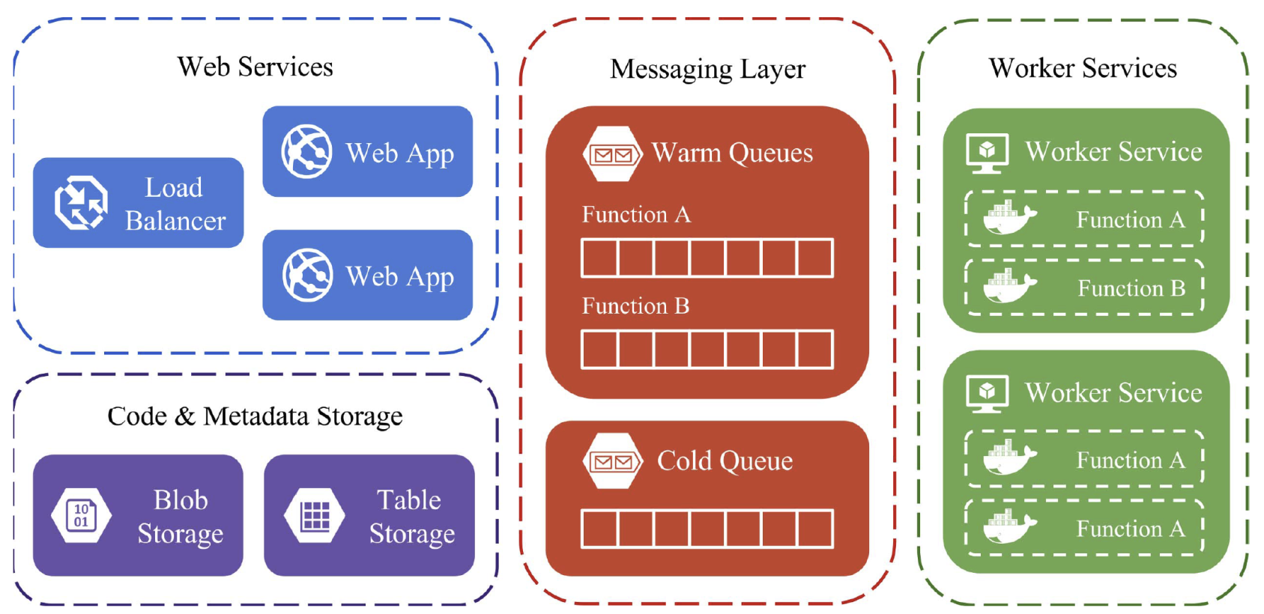
Prototype Components
Overview of prototype components, showing the organization of the web and worker services, as well as code, metadata, and messaging entities in Azure Storage.

Slide 26
Other Platforms
AWS Lambda
Azure Functions
Google Cloud Run functions
Apache OpenWhisk

Slide 28
Firecracker
https://github.com/firecracker-microvm/firecracker

Slide 29

Thank You & See You Again

